Slide 1
Idea
Universal Circuits have been theoretically proposed since 1976. [1]
Practical implementation made relevant by UC compiler (2016) [2]
Future of IP protection
Universal Circuits:
Main feature is the modular blocks used to implement a circuit
It converts a fixed circuit to “UNIVERSAL” circuit
Our Contribution:
Breaking UC using Photonic Side Channel
[1] Valiant, L. G., Universal circuits, Theory of computing 1976
[2] Kiss, Á., et al., Valiant’s universal circuit is practical, EUROCRYPT 2016
Notes:
Universal circuits have been presented as a theoretical concept since 1976 but their practical implementation has been made possible recently in 2016 by the UC compiler. They are touted as the future of IP protection due to the use of modular blocks to form any circuits. We use photonic side channel to break the UC.

Slide 2
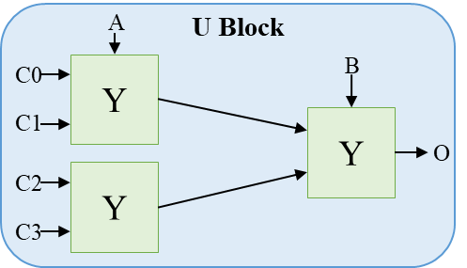
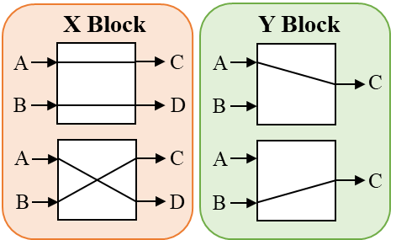
Universal Circuits
CB = 0
CB = 0
CB = 1
CB = 1
The secret : CONFIGURATION BITS
Configuration bits decide the behavior of the blocks
U – decide the 2-input gate type (4 bits)
X and Y - choose one of the 2 routing patterns (1 bit)
Notes:
UCs have 3 block types X, Y and U.
U blocks have 4 configuration bits which decide the type of 2 input gate it represents
Whereas X and Y are routing block using 1 configuration bits

Slide 3


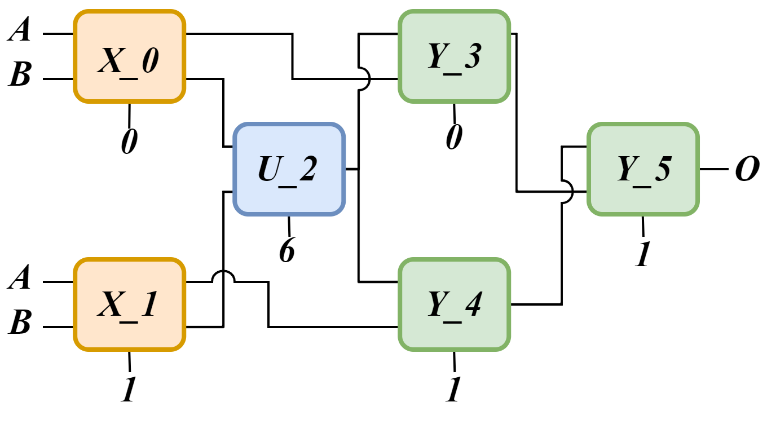
Attack Approach
Goal: Find the configuration bits
Side Channel: Photon Emission
Phases of attack:
Profiling: Building the dataset for each block
Attack: Capturing DUT images and using the dataset to get the configuration bit
Reason: Blocks have emission fingerprint for a specific configuration bit
HOW? Flip the inputs every clock cycle to generate photons
Universal
Circuit Compiler
Notes:
This configuration bits are the secret.
Anyone who knows the config bits knows the circuits and IP is stolen.
2 attack phases – profiling photon emission of each of the 3 blocks
using the profiling dataset to retrieve the configuration bits
How do we get photon emission from the circuit? Transistor emit photon when values are switched, so we flip the inputs continuously to get high photon emission.

Slide 4




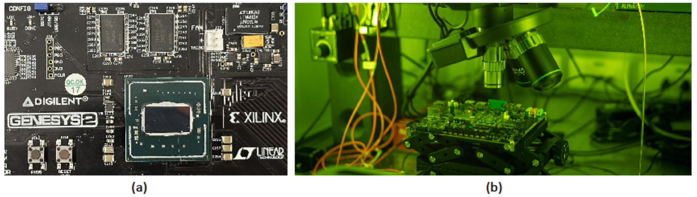
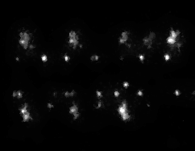
Experimental Setup
The experimental setup includes:
Computer to program FPGA, control the input through Arduino and post process the images
AlphaNOV to capture the photon emission
Gensesys 2 board - 28nm FPGA with Fan removed and FPGA de-lidded
FPGA
IR emission
Program
Images
UART
Control
Arduino
Notes:
Main part of the setup is the FPGA and the PEM
FPGA is programmed and controlled using a PC over Arduino
We have prepared the backside of the FPGA to be able to capture the photons

Slide 5
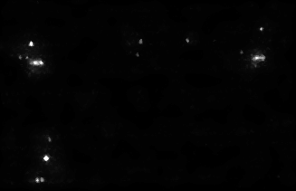
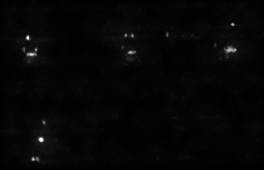




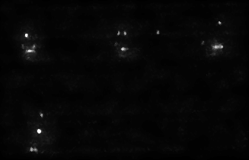
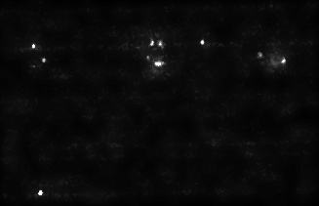
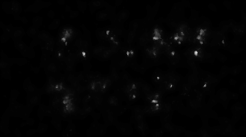
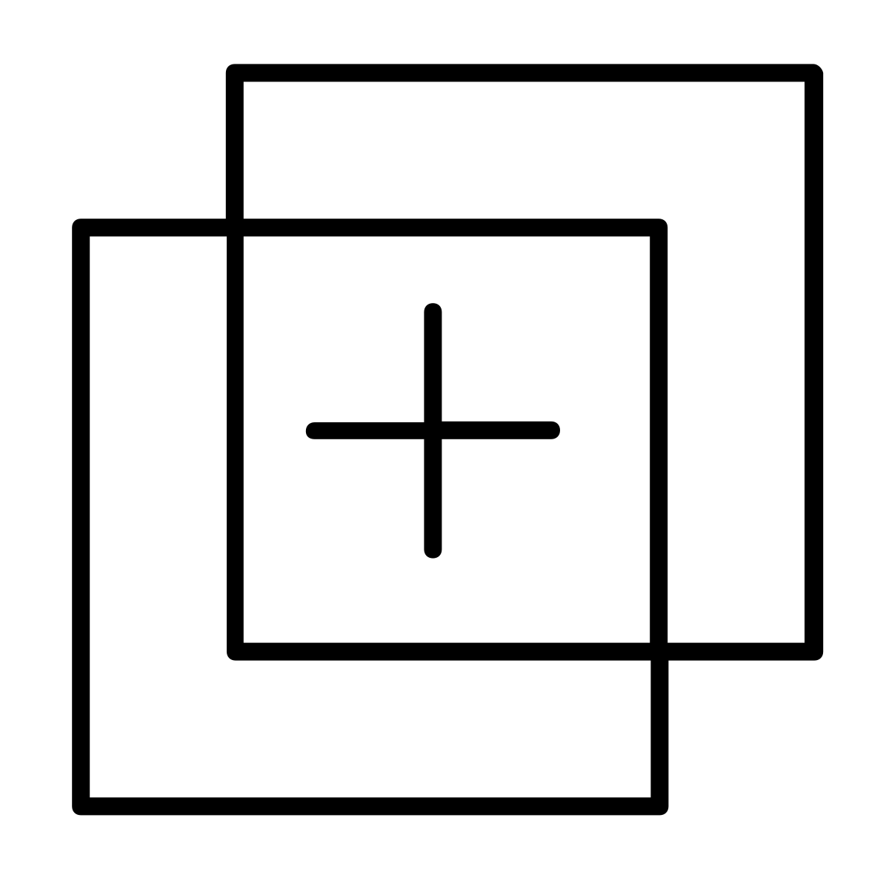
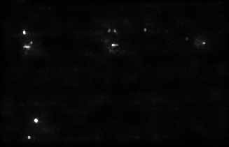
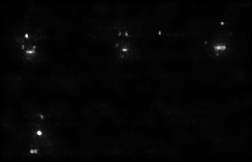
Revealing the Configuration Bit
Label: 2B
Label: 68
…
Label: 36
Bag of Features
Profiling Phase
Label the template images for each block
Form bag of features based on the extracted features
Attack Phase
Crop each block from the victim circuit individually
Use the query image and the bag of features to retrieve similar image
Find the rank based on the labels associated with the best match
Profiling Phase
Image Dataset
Label: 76
Label: 59
…
Label: 48
Query Image
Attack Phase
Image Retrieval by Similarity
Image Processing and cropping
Label: 69
Label: 59
Label: 48
Label: 68
Label: 88
SM: 55%
SM: 59%
SM: 76%
SM: 84%
SM: 92%
Rank 2
Notes:
Finally, I will show you how the whole process of extracting the config bits work.
First in the profiling phase, we create a dataset of different configuration bit and input patterns for each block.
This dataset is labelled and undergoes feature extraction to form a bag of features.
Then from the image of victim circuit a block is cropped and used as query image
Image retrieval by similarity is used to compare the query image to the bag of features to get top 5 similar images
From these set, the correct labelled image represents the rank. For example rank 2 here.

Slide 6
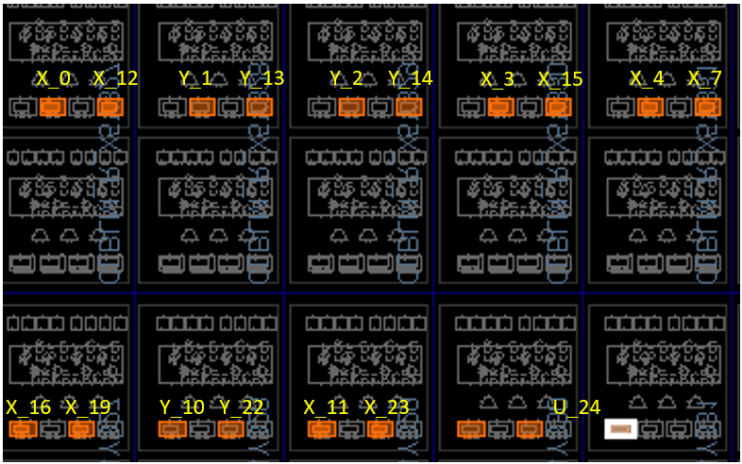
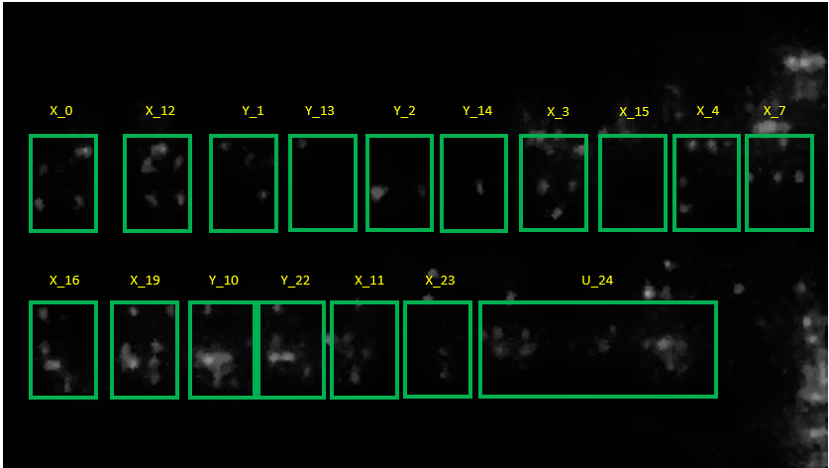
C17 circuit
C17 is part of ISCAS85 benchmark suite
6 gates -> 81 block UC design
Divide and Conquer – 2 inputs that lead to the first U block
Blocks of interest: 10X, 6Y and 1 U
Metric used: Success Rate
Success rate using only 6 images – 100%
Notes:
The victim circuit for our results is c17 circuit from the ISCAS85 benchmark suite.
6 gates blow up to 81 blocks using the compiler
We use divide and conquer approach to break first part of it using 2 inputs.
We are able to successfully find configuration bits of 17 of the 81 blocks with a success rate of 100%

Slide 7

Conclusion
We showed a vulnerability in UC construction
We also show that it is possible to extend the attack to UC for FPGA [1]
Scan for
The paper
[1] Disser, Y. et al., Breaking the Size Barrier: Universal Circuits meet Lookup Tables. In International Conference on the Theory and Application of Cryptology and Information Security 2023
Notes:
To conclude, we successfully broke the UC circuits using Photonic side channel
Also, The attack is agnostic about the UC compiler therefore it doesn’t matter which compiler you use to design, we have shown that most recent impolementation of the UC fpga can be broken

Slide 8


Thank you
Dmmehta2@wpi.edu
mehta-dev

